Slide 1

AN APPLICATION OF THE UNSCENTED KALMAN FILTER FOR SPACECRAFT ATTITUDE ESTIMATION ON REAL AND SIMULATED LIGHT CURVE DATA
Kent Rush

Slide 2
Introduction and Background

Slide 3
Introduction
This thesis attempts to estimate the attitude and angular velocities of earth orbiting objects using light curve data
Light curve data is easily accessible and plentiful. Developing methods of analyzing this data opens significant opportunities for research and analysis.
The ability to estimate attitude and angular velocity of space objects is particularly useful for spacecraft and mission identification, as well as applications for debris removal.

Slide 4
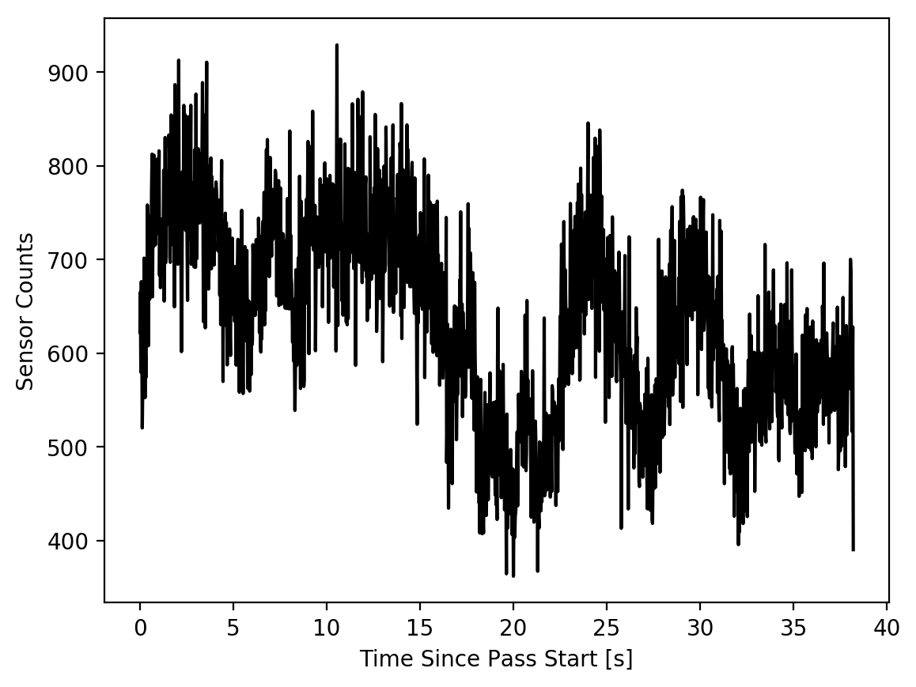
Light Curves
Data collected by observing the brightness of spacecraft as they pass overhead through a telescope
Long exposure images or rapid sequence of images
Camera CCD reports brightness as “counts” of photons
Object brightness is determined by its position, orientation, and reflectance properties
Light Curve Data from Sert-2 Spacecraft

Slide 5
Previous Work: Attitude Estimation
Attitude and Angular velocity estimation have been done before in simulation
Analysis of real data was attempted by
Previous estimations of angular velocity assumed it was constant, not tumbling

Slide 6

Indeterminacy
Solutions that recreate a light curve are not unique[18]
“Any light curve can be recreated using any combination of geometry and reflectance properties” [18]
It is impossible to distinguish between clockwise and counterclockwise rotation when the object is unresolved[18]

Slide 7
Kalman Filtering
A statistical method which combines a dynamic model and real measurements of a system to estimate its state.
Essentially finds the state that most accurately predicts the next measurement.
Requires a model of the system dynamics and of the measurement system.

Slide 8
Motivation and Project Definition

Slide 9

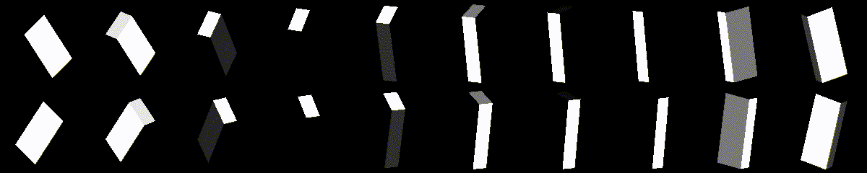
Project Definition
Estimate the attitude and angular velocity of real and simulated objects using an Unscented Kalman Filter
Develop two Kalman Filter formulations for tumbling and non-tumbling objects.
Investigate the effects of symmetry on converged solutions

Slide 10
Potential Applications of Attitude Determination from Light Curves
Debris Removal
National Security
Operations
How fast is this spacecraft spinning?
In what way is this spacecraft spinning?
Is this spacecraft pointing at targets of significance to national security?
Is my spacecraft behaving as expected?
Is my spacecraft under control?

Slide 11
Methodology

Slide 12
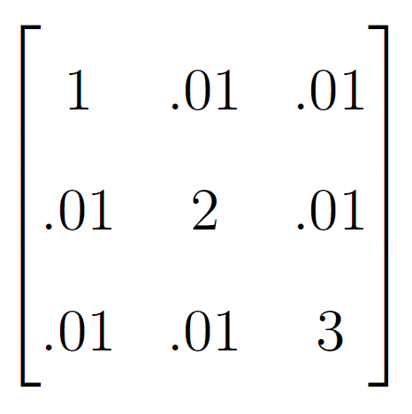
Kalman Filter Formulations
State estimates Modified Rodriguez Parameters and angular velocity.
For tumbling objects inertial properties are also estimated
Dynamic model is Eulers Equations of Motion
Measurement model is a combination of a Phong BRDF and Ray Tracing.

Slide 13
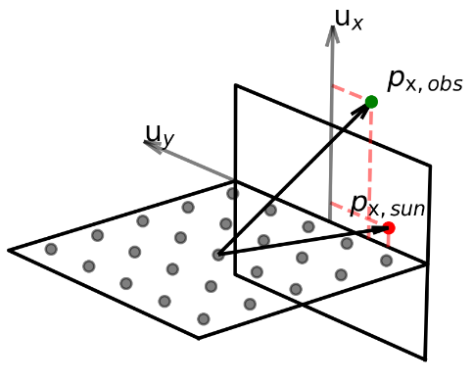

Measurement Model
“Ray Tracing”
Phong BRDF
Algorithm
Obeys conservation of energy
Accurately models decreasing diffuse component as incident angle decreases
Calculate the percentage of each facet that is not occluded
Apply the Phong BRDF model for the reflectance of each facet accounting for occlusion
Breaks up each facet into multiple small facets
Calculates the occlusion for each sub-facet given sun vector and observation vector.

Slide 14
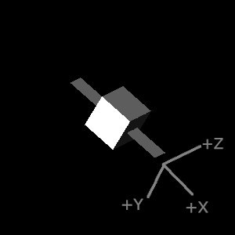
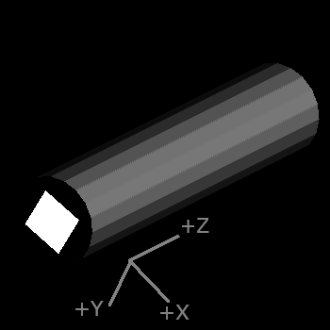
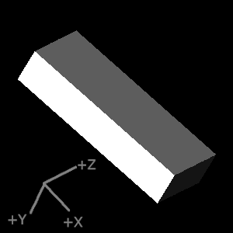
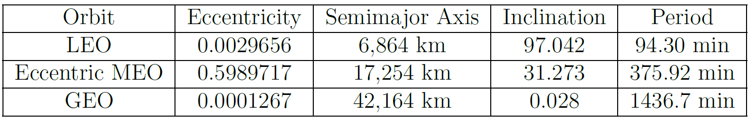
Simulated Data
Data was generated for various geometries across various orbits sampled over the course of a year.
Initial attitude was randomized
Data was discarded if the angle between the observer and sun was larger than 90 degrees

Slide 15
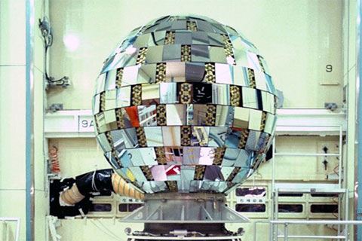
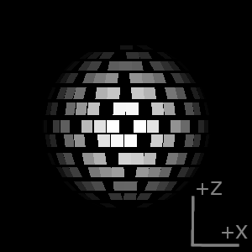
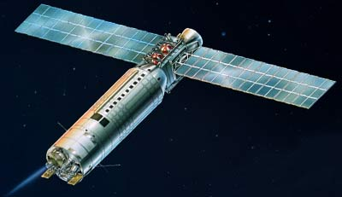
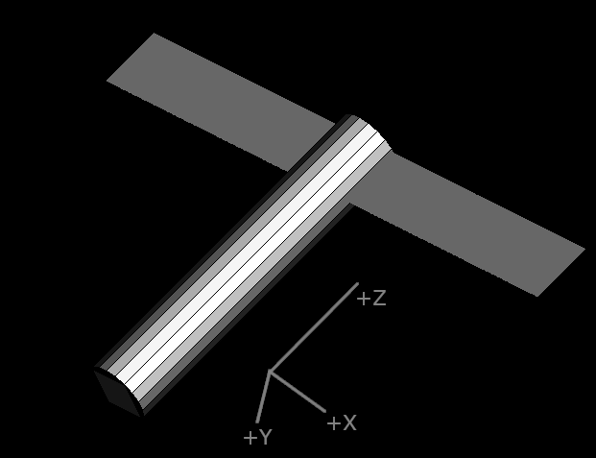
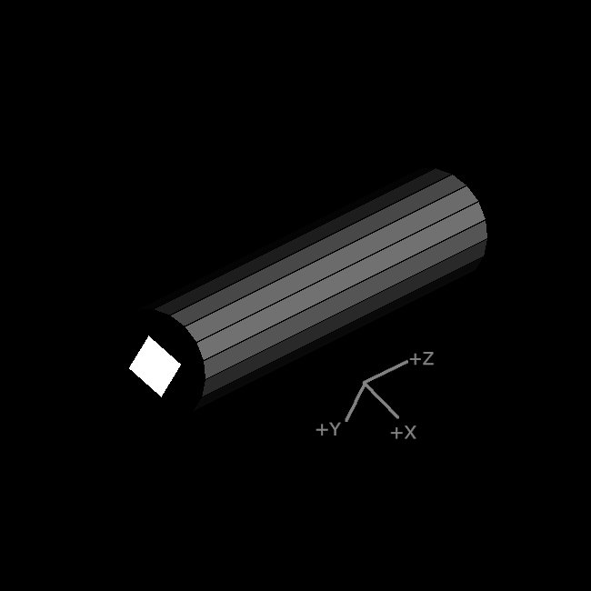
Real Data
Real data was provided by Lockheed Martin Space
These objects were selected due to their unique geometries and quality of data
The Kalman Filter applied to real data was tuned and verified on simulated data and then applied to real data
Ajisai (EGS)
Sert-2
Ariane-40 Rocket Body

Slide 16
Symmetrical solutions
After processing all the simulated trials, the results were searched for instances of alternative, symmetrical solutions

Slide 17
Validation

Slide 18
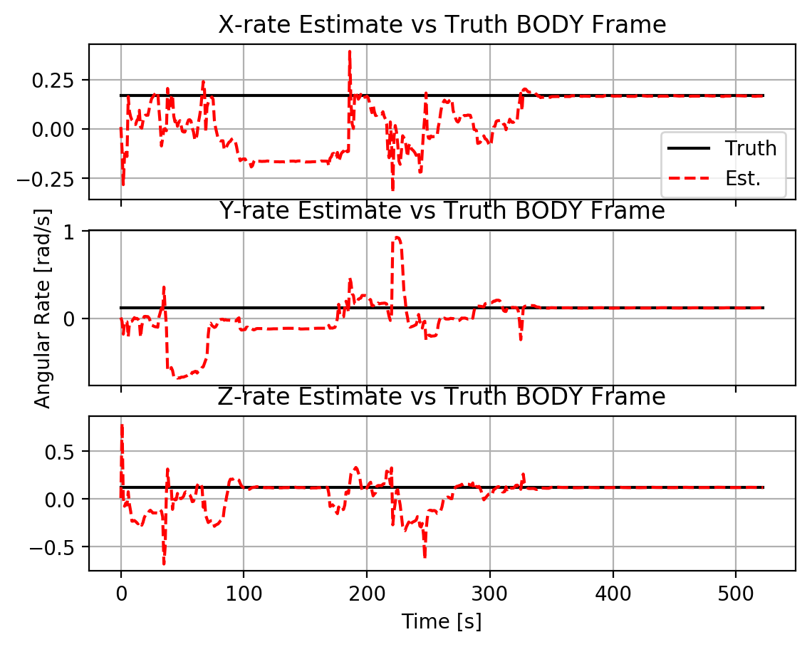
Convergence Criteria
Convergence of the Kalman Filter was determined by observing the updates to the state estimate
For the non-tumbling case, convergence was determined if the size of the updates to angular velocity were less than 1e-4 radians/second
For the tumbling case this was increased to 2e-3

Slide 19
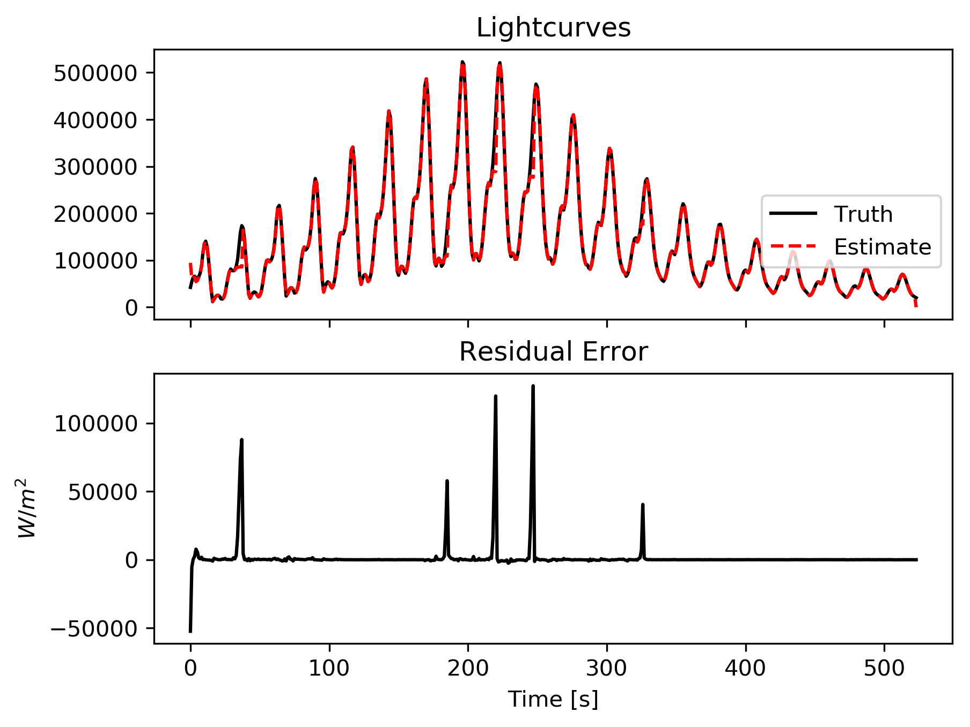
Residual Error
Once a solution was converged, its validity was evaluated by how well it fit the data
The light curve predicted by the state estimate was subtracted from the data
This residual is expected to converge near zero for a valid solution

Slide 20
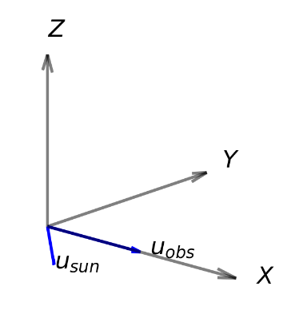
Symmetrical solutions
A solution was said to be symmetrical if the Z component of the angular velocity was the negative of the truth in the OBSERVATION frame
The observation frame is defined to have its XY plane coplanar to the sun and observation vectors. The Z axis completes the frame
Definition of the Observation Frame

Slide 21
Results

Slide 22
Simulation Results

Slide 23
Real Data Results

Slide 24
Analysis

Slide 25
Effects of Orbit

Slide 26
Effects of Geometry

Slide 27
Tumbling Solutions

Slide 28
Symmetrical Solutions

Slide 29
Results of Real Data

Slide 30
Conclusions

Slide 31
Is it possible to estimate tumbling objects

Slide 32
Can this be applied to real data

Slide 33
Are solutions using this method unique?

Slide 34
When does this method work best?

Slide 35
Future Work

Slide 36
Future Work
Improved Reflectance Model
UKF Improvements

Slide 37
Future Work
Orbit Estimation
Improved Data Acquisition

Slide 38
Sources

Slide 39
P. Magnusson, M. A. Barucci, J. D. Drummond, K. Lumme, and S. J. Ostro. Determination of pole orientations and shapes of asteroids. In R. P. Binzel, T. Gehrels, and M. S. Matthews, editors, Asteroids II, pages 67{97, Jan. 1989.

Slide 40
Backup Slides

Slide 41
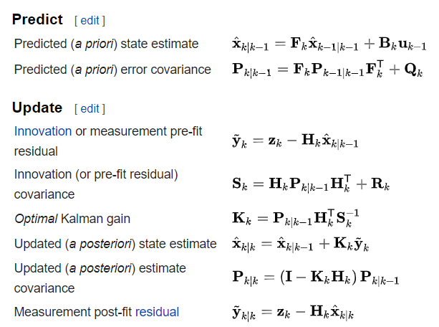
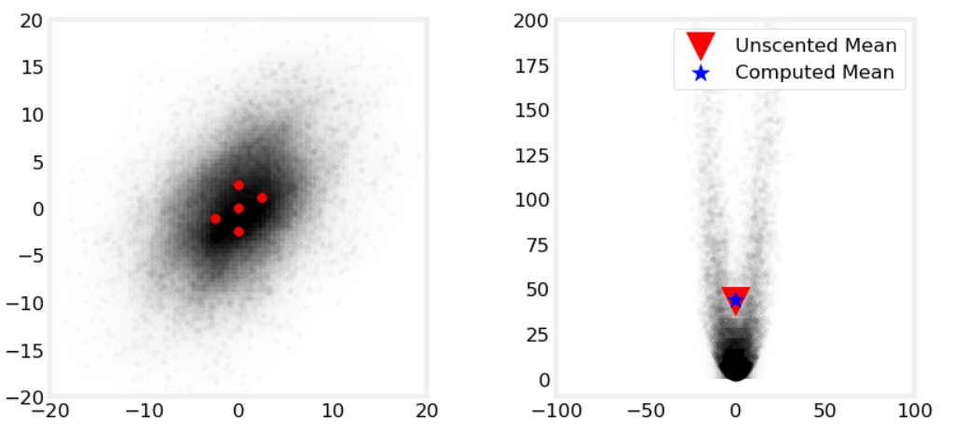
EKF vs UKF
Extended Kalman Filter Algorithm
Sigma points being transformed by non-linear function
From Kalman-and-Bayesian-Filters-in-Python by Roger Labbe.
https://github.com/rlabbe/Kalman-and-Bayesian-Filters-in-Python/blob/master/10-Unscented-Kalman-Filter.ipynb
From Wikipedia: Kalman Filter

Slide 42
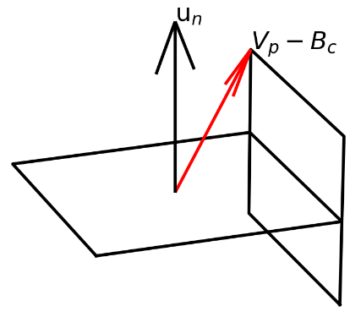
Ray Tracing Model

